Slide 1

COOL STUFF SHOWCASE

Slide 2

SYLLABUS
Notes:
THE POINT OF THIS IS NOT TO –DO IT THE RIGHT WAY –
ITS ABOUT SEEING WHAT FITS AND STARTING TO DEVELOP YOUR PRACTICE AS A DESIGNER / ARTIST / AMKER
-> point of lab is to support alex teaching you about concept & form
-> im gonna teach you some researching tools, ways to support your making process
->WORK SESSION DOES NOT MEAN DON’T BEING ANYTHING NEW INTO CLASS!!
THESE WILL BE ONE:ONE & DEBUGGING SESSIONS I WANT TO SEE YOUR PROTOTYPES
WORK SESSIONS / TECHNICAL SESSIONS -> there are a bunch of open weeks…
I want to teach you stuff that can actually best help you

Slide 3
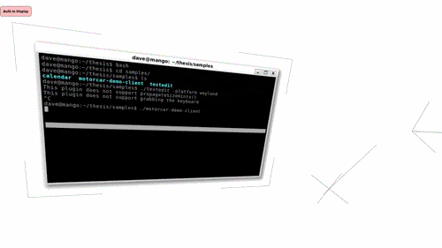
TECH SESSIONS
Notes:
WORK SESSIONS / TECHNICAL SESSIONS -> there are a bunch of open weeks…
I want to teach you stuff that can actually best help you

Slide 4

ASSIGNMENT ONE
Notes:
OVER THE NEXT FEW WEEKS I WILL BE TEACHING YOU WAYS TO
RESEARCH
TEST
PROTOTYPE
ALL WITH THE FOCUS OF THE EARLY TAGES OF DEVELOPMENT PRE-BUILDING
THESE ARE WAYS TO PLAN YOUR CONCEPT, TEST IT BEFORE MAKING IT, HELPING YOU GET TO THE CORE OF WHAT YOU ARE MAKING
FOR ASSIGNMENT ONE YOU WILL NEED TO USE AT LEAST TWO OF THESE TECHNIQUES OR SOMETHING WE HAVE DISCUSSED IN CLASS TO FURTHER YOUR RESEARCH FOR THE ASSIGNMENT BRIEF ALEX GAVE YOU
THE PURPOSE OF THIS IS TO START USING THESE TOOLS TO COMMUNICATE
AND TO START USING THEM TO PROTOTYPE – A PROTOTYPE DOESN’T NEED TO BE A FUNCTIONING THING
ITS TO CAPTURE THE ESSENCE OR TEST A FUNCTION OR PUSH THE BOUNDARIES OF THE IDEA -> THIS IS HOW YOU FGURE OUR ROAD BLOCKS ETC ETC ETC…

Slide 5
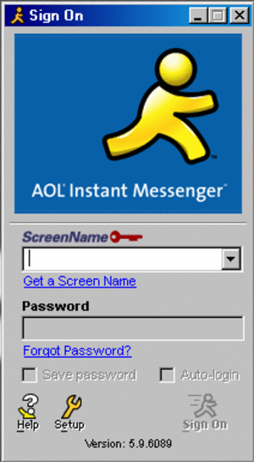
SLACK
Notes:
THIS IS FOR US TO COLLABRATE ETC ETC ETC

Slide 6

RESEARCH
Notes:
HOW DO YOU GUYS RESEARCH?
-> IMMERSING YOURSELF -> THIS IS HOW YOU FIND ABOUT THESE NEW THINGS
MUZLI
PINTEREST
INSTRUCTABLES
ADAFRUIT
CODEPEN
STACK OVERFLOW
MEDIUM
NONSENSENYC
ELLO
FINDING WAYS TO SAVE THIS INFO FOR YOU TO SEARCH THROUGH
THIS IS WHY WE DOING SLACK
BUT YOU WANT MULTIPLE
POCKET, EVERNOTE,
NEED FINDING
TRADITIONALLY WITH A SPECIFIC BRIEF BUT YOU WANT TO LOOK FOR PAIN POINTS AND INTERESTING OPEN GAPS IN CONVERGING AREAS ETC ETC
TWITTER CAN BE HELPFUL
INSTAGRAM
TUMBLR
TECHCRUNCH
PRODUCTHUNT
YOU WANNA FIND YOUR STAKES IN THE GROUND
ACADEMIC RESEARCH
PAST THESIS
MIT

